Slide 1
SSV: Swept Sphere Volumes for Collision detection and Proximity
Steve Meister
RMP
Fast Proximity Queries with Swept Sphere Volumes
Eric Larsen, Stefan Gottschalk, Ming C. Lin, Dinesh Manocha. University of North Carolina.
Notes:
Mention the exact papers you’re presenting, change to actual title of the paper. Make sure you don’t hav elong stretfhes of slides with no images…..

Slide 2
Glossary
BV: Bounding Volume
AABB: Axis Aligned Bounding Box
OBB: Oriented Bounding Box
k-DOP: k sided Discretely Oriented Polytopes
BVH: Bounding Volume Hierarchy
BVTT: Bounding Volume Traversal Tree
PSS,LSS,RSS: Point, Line, Rectangle Swept Sphere

Slide 3
Algorithm Objectives
Collision Detection: look for geometric contact
Separation Distance: finding the minimum Euclidean distance between two objects.
Approximate Distance: compute separation distance allowing for a specified error (faster).
Most codes that do these operations in a general and efficient way use Bounding Volume Hierarchies (BVH).

Slide 4
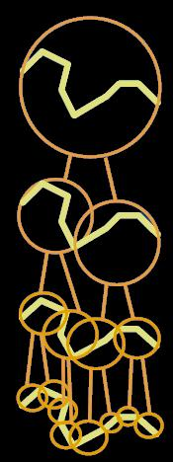
Bounding Volume Hierarchies
A BVH is a tree structure of BVs which get smaller and smaller as you descend the tree. So each BV child is smaller than its parent.
A BVH can be made of up any type of bounding primitive (PSS, LSS, AABB, OBB) or a mix of bounding primitives.
Mixed BVHs require more complex collision/distance calculation code (however there are disadvantages).
Notes:
Cite where you get the images from.

Slide 5
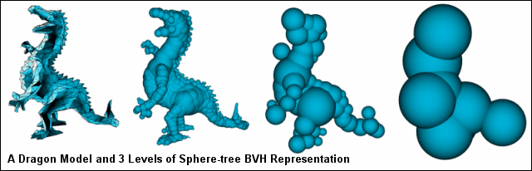
Bounding Volume Hierarchies (Example: Spheres, PSS)
Notes:
Maybe describe how they came up with this thing and hy it is backwards, ottom up or top down.

Slide 6
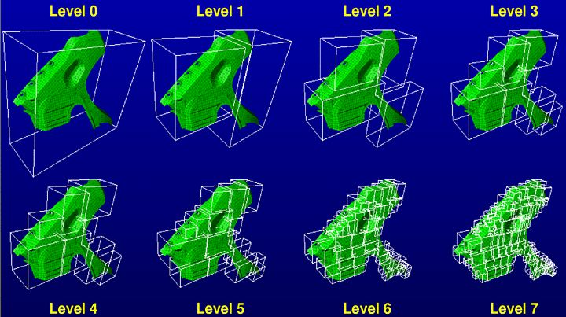
Bounding Volume Hierarchies (Example: AABB)

Slide 7
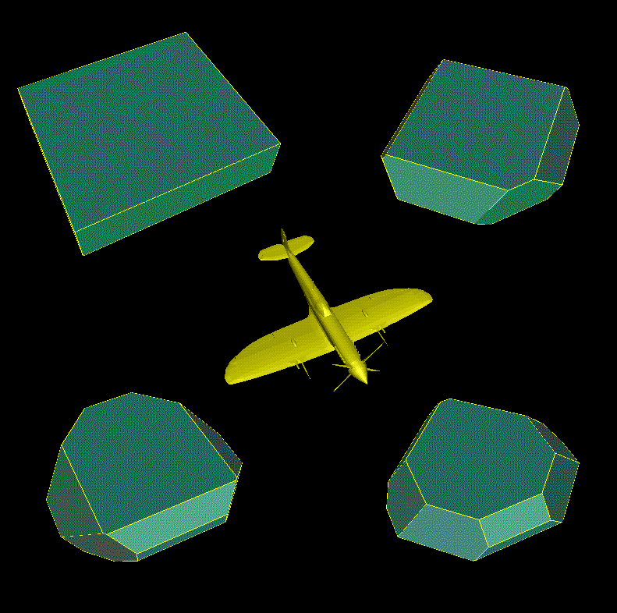
Bounding Volume Hierarchies (Example: k-DOPs, k=6,14,18,26)
Level 0
Note: k=6 is a AABB.
Notes:
Make note that this isn’t what the presentation is on, it’s ust a quick demo using k-DOPs

Slide 8
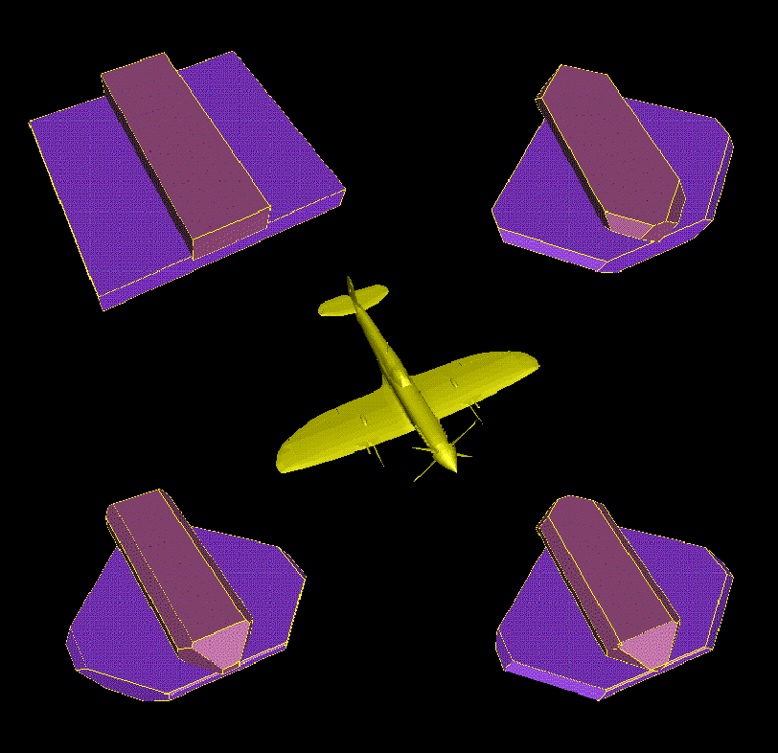
Bounding Volume Hierarchies (Example: k-DOPs, k=6,14,18,26)
Level 1

Slide 9
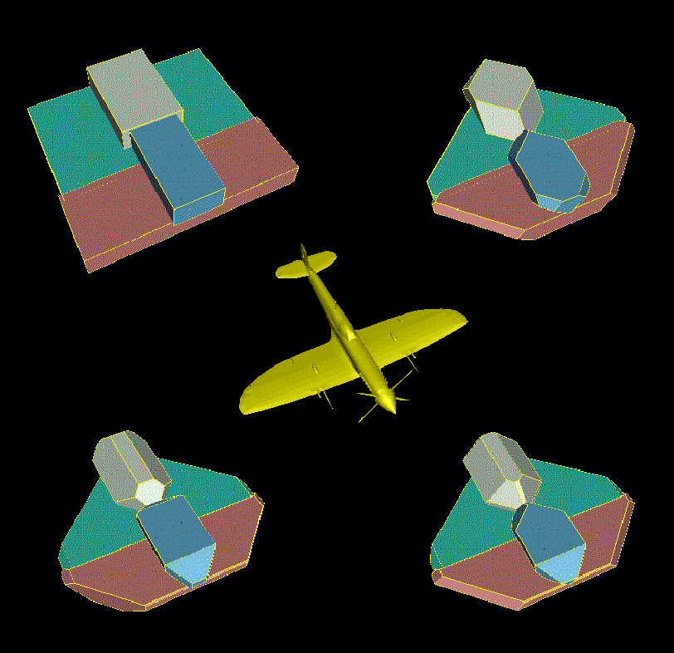
Bounding Volume Hierarchies (Example: k-DOPs, k=6,14,18,26)
Level 2

Slide 10
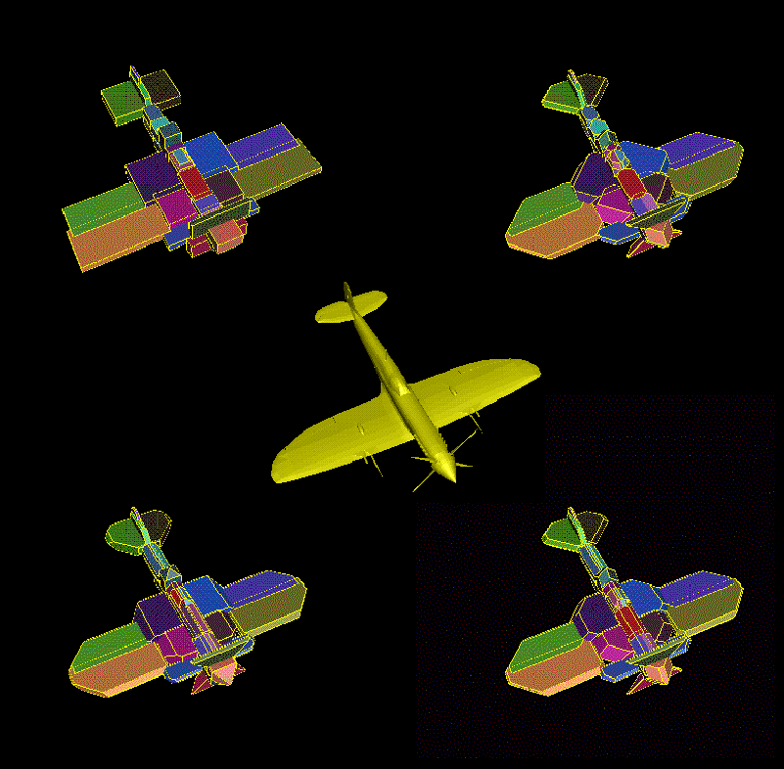
Bounding Volume Hierarchies (Example: k-DOPs, k=6,14,18,26)
Level 5

Slide 11
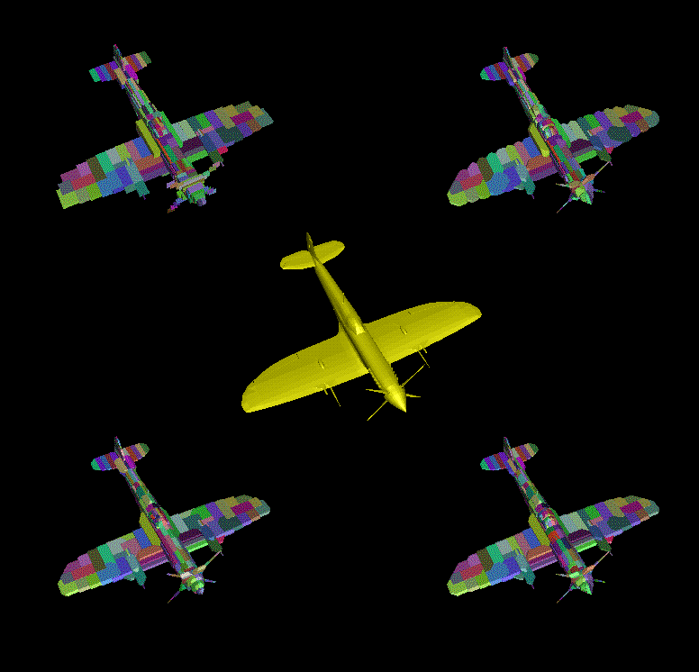
Bounding Volume Hierarchies (Example: k-DOPs, k=6,14,18,26)
Level 8

Slide 12

Bounding Volume Collisions
Collision Detection:
  Each BV is compared starting at the top level.
  If the BVs are in collision then their children are also checked for collision.
  If the BVs are not in collision then the algorithm will not search any of the children BVs
  If the node of the BVH is a leaf node (lowest node) then the actual primitives (triangles) are compared directly.

Slide 13
Bounding Volume Distances
Separation Distance: (similar to collision)
  Smallest distance from primitive comparisons is stored (in variable ε). At start ε is initialized to something very large or the distance between random primitives.
  The distance between each BV is computed and if the distance is greater than the current ε then the children are NOT searched.
  If the distance between BVs is less than the current ε estimate then the children of that BV are checked.
  The current ε is updated along the way.

Slide 14

Bounding Volume Approximate Distance
Approximate Distance:
  More aggressive than actual distance.
    Prune only if
      ε/(1+R) < Distance(A,B)
      R = relative error (as R->0, becomes exact distance)
  If the current ε isn’t reduced by more than a certain tolerance then the BV’s children are not searched.
Notes:
Explain the aggressive part or make a note about it on the slide…

Slide 15
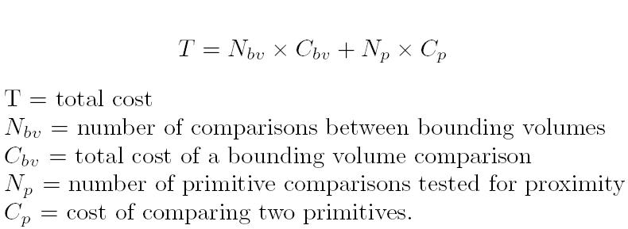
Proximity Query Computational Costs
The goal is to minimize T. This can be done by making N smaller or C smaller. However one is usually reduced at the cost of making the other larger.

Slide 16

Proximity Query Computational Costs
Spheres, AABB : high N, low C
k-DOPs, RSS, OBB: low N, High C
Hybrid schemes have been proposed to take advantage of the fast testing of Spheres and the tight fit of RSSs and OBBs.
One hybrid scheme includes PSS,LSS and RSS (all are SSVs)
Hybrid disadvantages ( n BVs, O(n^2) checks )

Slide 17
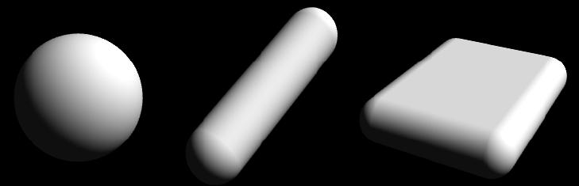
Swept Sphere Volumes
These volumes are the Minkowski sum of a sphere of given radius and a primitive shape (Point, Line, Rectangle).

Slide 18
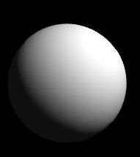
Point Swept Sphere
Advantages:
  Very low collision testing cost
  Low storage requirements
  Very Simple
Disadvantages:
  Poor fit to most geometry

Slide 19
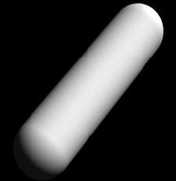
Line Swept Sphere
Advantages:
  Low collision testing cost
  Potentially better fitting than a normal sphere.
  Good compromise between very simple and very complex BVs
Disadvantages:
  Poor fit to some geometry compared to RSS and OBB

Slide 20
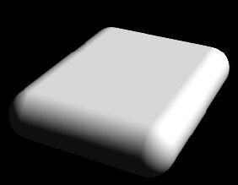
Rectangle Swept Sphere
Advantages:
  Much tighter fit to geometry than PSS and LSS
Disadvantages:
  Higher calculation costs when compared to PSS and LSS.
  Requires more storage space than PSS and LSS.

Slide 21
Swept Sphere Volumes
All 3 shapes can be used simultaneously in a hybrid scheme. Consider each as a member of a single family.
Use varying tightness of fit where it is needed most to make proximity queries more efficient. –demo-
Notes:
Make sure not to be too verbose. Make things as short as possible, this second bullet is worded a little to thickly

Slide 22
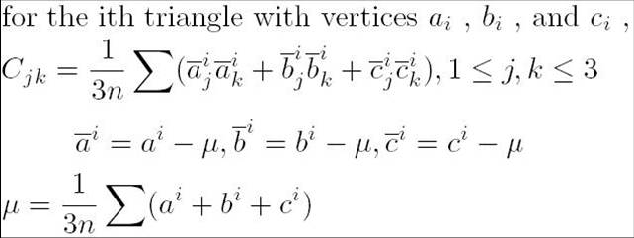
Statistical Swept Sphere Volume Generation
Given a group of n triangles…..
C is a sample covariance matrix.
μ is the sample average vector.
Notes:
Go in a litle about covariance matries and about how their eigen vectors are the princible axes.

Slide 23
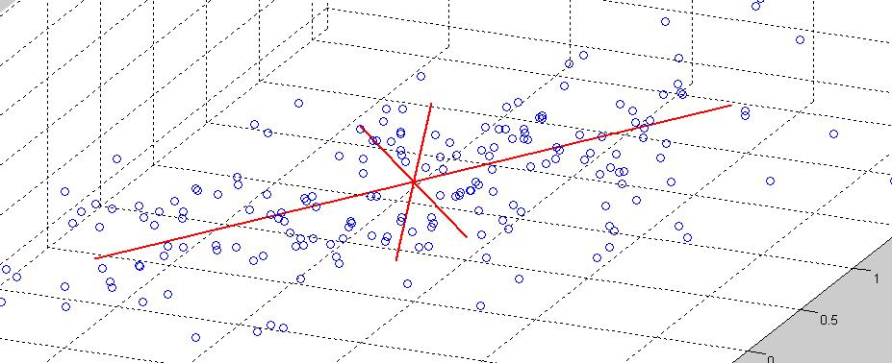
Statistical Swept Sphere Volume Generation
The eigenvectors of the Covariance matrix form the principal axes of the SSV used to fit to the triangle points.
Notes:
Check spelling on principal…
Also, maybey add more detailed descriptions of the ittle of the slide, don’t make a ton of them in a row all the same.

Slide 24
Statistical Swept Sphere Volume Generation
PSS:
  Simply enclose all the points in the distribution in a single Sphere
LSS:
  Use the largest dimension (along one of the 3 Cov-Matrix axes) as the height of the cylinder and choose the radius to enclose all the points
RSS:
  Largest 2 dimensions (along the Cov-Matrix axes) are the length and width of the rectangle. The radius is chosen to enclose all the points.
-demo-

Slide 25
Statistical Swept Sphere Volume Generation
BVH generation, Multiple levels of BVs.
    Uses the same method as OBBTree (a OBB collision detection method/algorithm).
  Longest Dimension is split in two via an orthogonal plane
  Primitives are set on one side or the other depending on which side of the plane their centroid is on.
  Each group of primitives is then set inside another BV, one level lower.
  For PQP, primitives are always triangles (preprocessing step)
  -demo-
Notes:
Fix the first bullet, make it a little more clear. Make note to say that the primatives are triangles for PQP (but not always for other libraries)

Slide 26
Computing Separation Distances
Distances are computed from BV to BV by considering the BV primitive (Point, Line, Rectangle).
Once this distance is computed the radius of the SSV BVs is subtracted.
All these distances are computed with one algorithm (rectangle to rectangle distance) each other combination is either a subroutine or a special case.
Notes:
Last bullet might be a little verbose and unclear. Go into how they use the Rect-Rect for other pieces and what they use for triangle-to-triangle distance calculation (not GJK ?)

Slide 27
Separation Distance Algorithm (Rectangles)
First determine if the closest points are on a rectangle edge or not (16 cases to test –demo-).
  External Voronoi regions are used to determine if closets points are on an edge.
If not then one of the points must be in a rectangle interior.
  Use separating axis test (from GLM96)
  Uses method proposed by Lin & Canny in ‘91

Slide 28
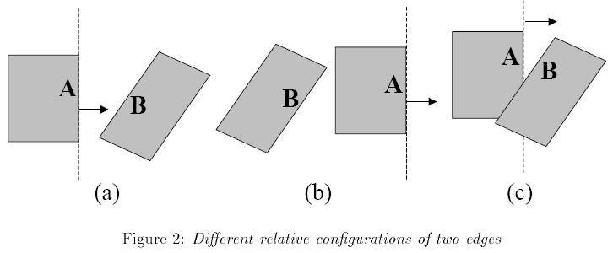
Computing Separation Distances
Rectangle to Rectangle distances are computed via considering the external Voronoi regions of each rectangle line segment. These regions are used to find the closest points on the closest line segments of a rectangle in 3D space.
Notes:
Be preparied for questions on condition C and be able to explain how the handle it in their code PQP and algorithm SSV

Slide 29

Computing Separation Distances
Line segments are first compared to see if they are in each others external Voronoi regions.
Depending on this result a distance may be returned or the rectangles may be overlapping (surface normal distance computed fig 2c).

Slide 30
Computing Separation Distances
Computing distance from Point to Line, Point to Rect, Line to Line are all subroutines of the Rect to Rect routine.
Computing Line to Rect distance is a special case of the Rect to Rect distance routine.
Notes:
Check up on the whole “special case” thing, make sure it’s not a smashed rectangle treated as a line, don’t say that.

Slide 31
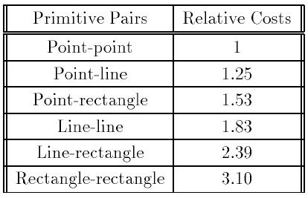
Computing Separation Distances
Relative Costs of Distance Computations.

Slide 32
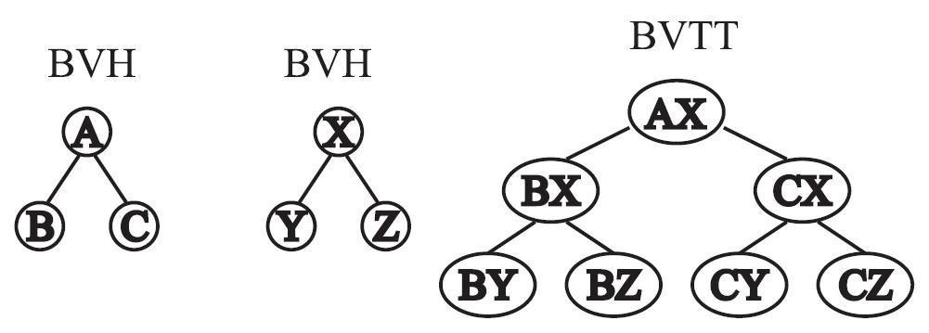
Bounding Volume Traversal Trees
BVTT display all possible BV test pairs for object collision detection/distance calculation.
(“Maximal BVTT” shown on right)

Slide 33
Bounding Volume Traversal Trees
Efficiency is changed depending on how the BVTT is traversed.
Notes:
BVTT might want to be placed after the BVH stufff, get the general collision detection done first then do the SSV stuf..

Slide 34
BVTT Pruning
To avoid searching the maximal BVTT in totality, an estimate of the distance (ε) is constantly updated and used to avoid searching unnecessary nodes.
Distance between BVs is used as a lower bound on ε. If this lower bound is above the current distance estimate, the node is pruned from the tree.
Notes:
Their might be some redundancies with the BVTT pruning and how the BV’s collide and how to get through them as presented much earlier.

Slide 35
BVTT Traversal Methods
Depth-first.
Breadth-first.
Priority Directed Search.
Triangle Caching.
Combined Triangle Caching and Priority Directed Search.
Primary goal is to get to the proper Euclidean distance as fast as possible.

Slide 36
Priority Directed Search
Search through child nodes of the closest BVs first.
Goal here is to reduce ε as fast as possible.
BV distances provide a lower bound and are pruned if they are > ε in distance
Priority Queues can be used (nodes are ordered with ascending ε values).
Makes use of spatial coherency.
-demo-

Slide 37
Triangle Caching
Past calculations of distance can be used to initialize ε.
If only small motions are made, the initial ε estimate will be very close to actual ε. This should make the search closer to the minimal BVTT
Makes use of temporal coherency.
-demo-

Slide 38
Separation Distance as Collision Detection
Computing the Separation distance between two primitives is the logical equivalent of computing the collision detection between two primitives with dilations (the minimal BVTT will be the same)
A dilation (a SSV) is the Minkowski sum of a sphere and a primitive shape.
Allows analytic knowledge of collision detection to be used to better understand distance calculation.
Notes:
He says “So what, big deal” .. Make a slide about what this means exactly… Go back into this, this is not somehting usless, must have a point, find it.

Slide 39
Dilated Collision Phenomena
The closer the objects are the easier the collision detection will be. Generally.
Complexity can not be reduced by increasing distance. Due to increased overlap the opposite effect is observed.

Slide 40
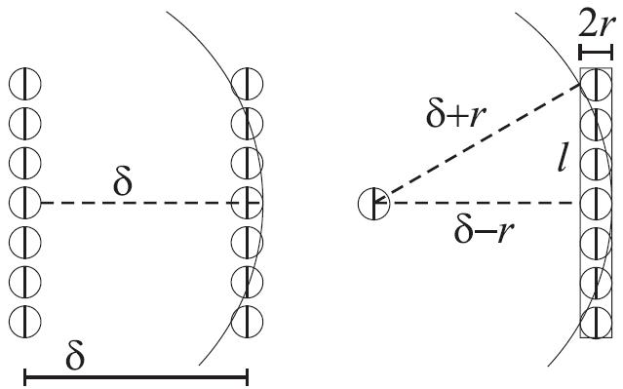
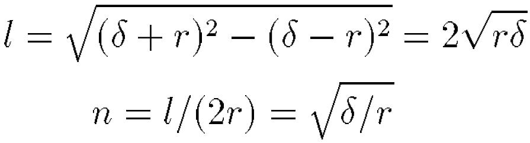
Dilated Collision Phenomena

Slide 41
Implementation and Results
The SSV collision detection/Proximity Query algorithms are implemented in the PQP package from UNC
Can be found at http://www.cs.unc.edu/~geom/SSV/
More cool stuff at http://www.cs.unc.edu/~geom/

Slide 42
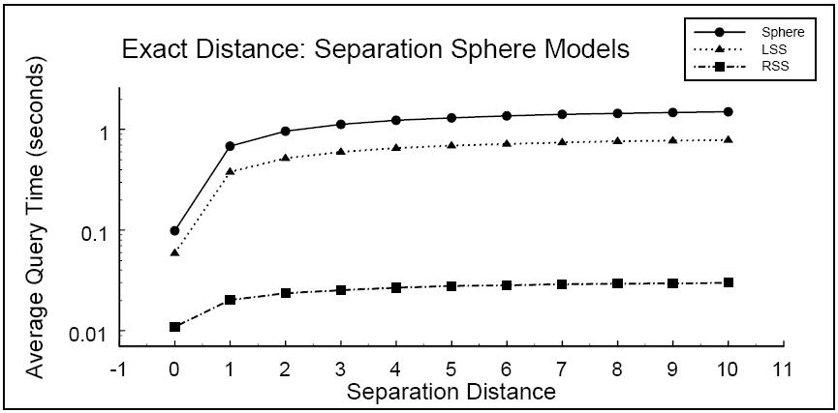
Results for Sphere Model Distance
2 40K polygon unit spheres

Slide 43
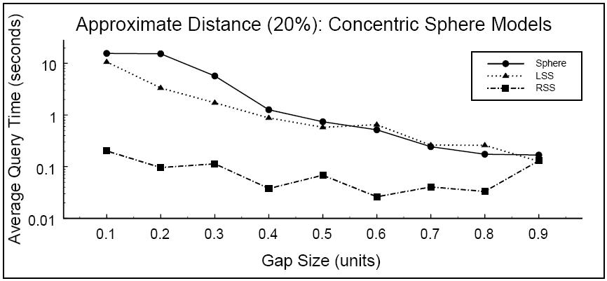
Results for Concentric Sphere Approximate Distance
2 40K polygon sphere shells

Slide 44
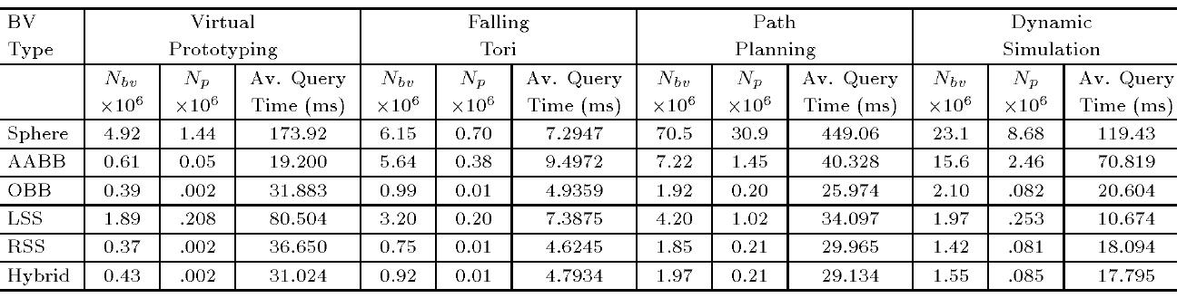
Collision Detection Benchmarks
OBBs from RAPID and V-COLLIDE, AABBs from SOLID.

Slide 45
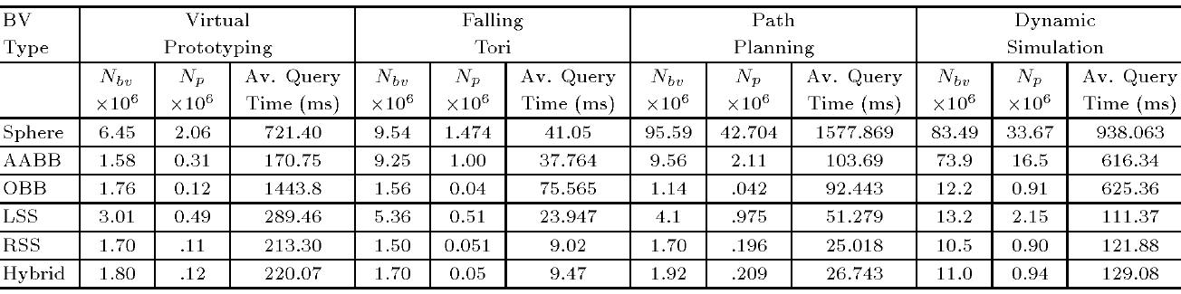
Distance Calculation Benchmarks
OBBs from RAPID and V-COLLIDE, AABBs from SOLID.

Slide 46
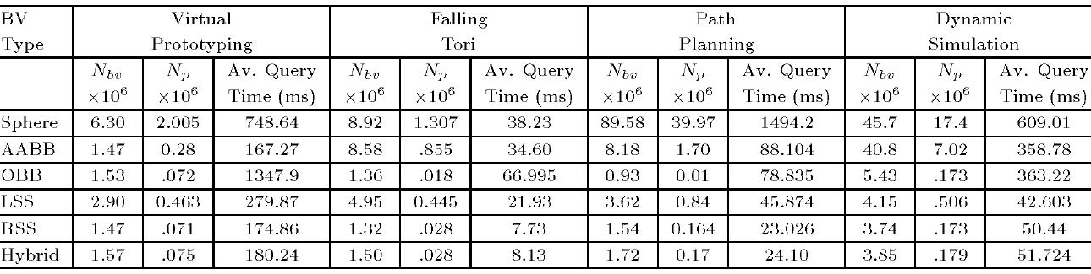
Approximate Distance Benchmark
OBBs from RAPID and V-COLLIDE, AABBs from SOLID.
Approximate Based on 10% allowable relative error.

Slide 47
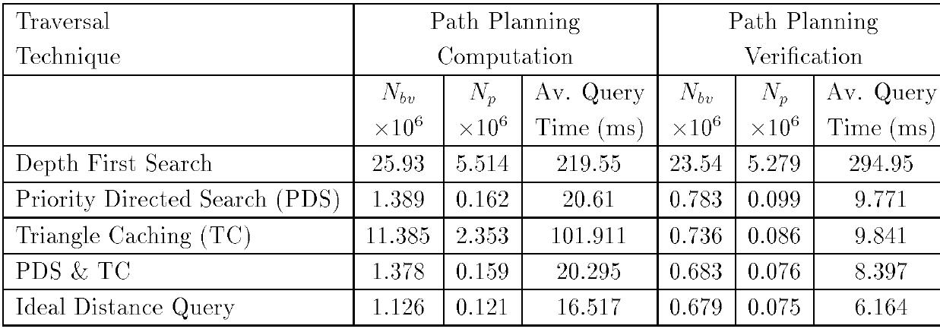
BVTT Traversal Methods
For RSS separation distance times.

Slide 48
Videos

Slide 49
Future Work
k-DOPs and families (multiple k values).
Classification of uses, proper BV families
Penetration depth algorithms

Slide 50
Questions?

